Slide 1


SMART INDIA HACKATHON 2026
TITLE PAGE
Problem Statement ID- SIH26093
Problem Statement Title- AI-Based Real-Time Stress and Trauma Assessment Module for Victims/Complainants Accessing NHAA (14566) and Integrated Portal
Theme- MedTech / BioTech / HealthTech
PS Category- Software
Team ID-
Team Name – Veom Vegas

Slide 2

IDEA TITLE
IDEA/SOLUTION: SVI — Smart Victim Intelligence
“From Listening to Meaningful Support”
Problem Resolution:
➤ Detects emotional distress during the interaction itself.
➤ Helps identify high-risk cases earlier.
➤ Supports prioritization of cases requiring human attention.
➤ Converts unstructured conversations into actionable assessment insights.
➤ Enables consistent assessment across helpline and digital channels.
SVI is an AI-powered real-time stress and trauma assessment module integrated with NHAA (14566) and its digital access channels. It analyzes voluntary interactions such as text, voice and user responses to identify indicators of emotional distress and trauma.
The proposed system will :
➤ Perform real-time stress and trauma assessment using AI/ML.
➤ Analyze textual and conversational signals to identify indicators such as distress, fear, anxiety, hopelessness and emotional overload.
➤ Use multimodal AI to combine linguistic, conversational and, where consented, voice-based indicators.
➤ Generate a non-diagnostic stress/trauma risk score and categorize cases into appropriate severity levels.
➤ Provide early alerts and priority indicators to authorized support personnel.
➤ Recommend appropriate support pathways, such as counselling, human intervention or emergency escalation based on predefined protocols.
➤ Maintain privacy, consent and secure handling of sensitive information throughout the assessment.
Unique Value Propositions:
➤ Real-time AI-assisted assessment.
➤ Multimodal stress & trauma analysis.
➤ Early identification of high-risk cases.
➤ Human-in-the-loop intervention.
➤ Multilingual and accessible design.
➤ Privacy-first and consent-driven architecture

Slide 3
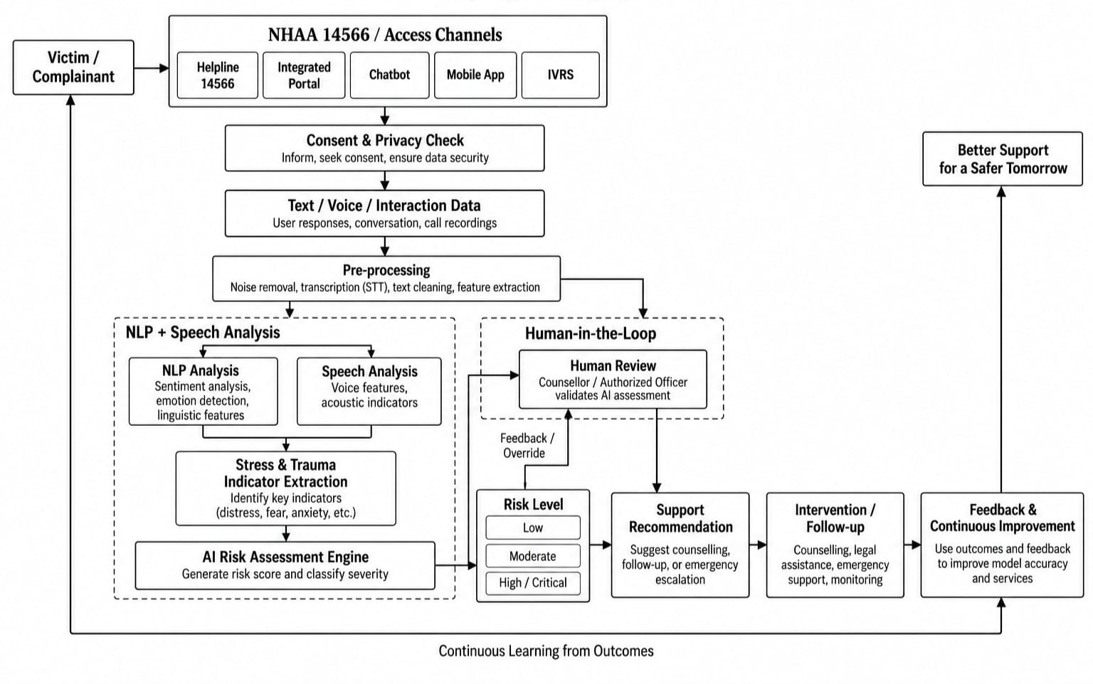
Work Flow
Tailwind CSS • MongoDB • Express • React • Node.js
PyTorch • Keras • Python • OpenCV
Google Maps • GraphQL • AWS • Django

Slide 4
FEASIBILITY AND VIABILITY
Feasibility of the Idea:
Potential Challenges, Risks and its overcomings:
➢ Technical Feasibility: Uses established AI technologies including NLP, speech processing, transformer models and classification algorithms, making real-time assessment technically achievable.
➢ Operational Feasibility: The module can operate as an assessment layer over existing NHAA channels without requiring complete replacement of the current infrastructure.
➢ Scalability: A modular API-based architecture allows deployment across:
14566 Helpline → Web Portal → Chatbot → Mobile App → IVRS
➢ Economic Feasibility: Cloud-based deployment and modular AI services can reduce infrastructure requirements while allowing resources to scale according to demand.
➢ AI Bias & Accuracy:-
Challenge: Emotional expressions vary across languages, cultures and individuals.
❖ Solution: Diverse datasets, continuous evaluation, fairness testing and human validation.
➢ False Positives / False Negatives:-
Challenge: AI may incorrectly classify emotional states.
❖ Solution: Use AI as a decision-support system, not an autonomous diagnostic system, with human review for high-risk cases.
➢ Privacy & Data Security:-
Challenge: Victim conversations can contain extremely sensitive information.
❖ Solution: Consent-based collection, encryption, access control, data minimization and secure storage.
➢ Multilingual & Dialect Variation:-
Challenge: Users may communicate in different Indian languages and dialects.
❖ Solution: Multilingual NLP/STT models with language detection and continuous dataset improvement.
➢ Adversarial / Manipulated Responses:-
Challenge: Users may unintentionally or intentionally provide incomplete information.
❖ Solution: Combine multiple interaction signals and use confidence scores instead of relying on a single response.

Slide 5
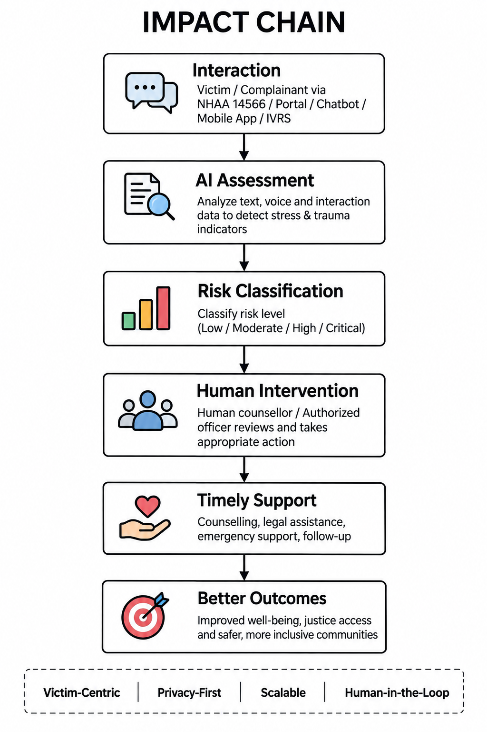
IMPACT AND BENEFITS
Early Detection of Distress:
➢Impact: Real-time identification of stress and trauma indicators during victim/complainant interactions.
➢ Benefit: Enables earlier attention to individuals who may require additional support.
Prioritized Human Intervention:
➢ Impact: AI-generated risk levels help authorized personnel identify cases requiring urgent attention.
➢ Benefit: Better allocation of limited counselling and support resources.
Improved Victim Support:
➢ Impact: Converts conversational information into structured support insights.
➢ Benefit: More responsive and personalized assistance while reducing dependence on manual screening alone.
Multilingual Accessibility:
➢ Impact: Supports interactions across diverse linguistic backgrounds.
➢ Benefit: Makes AI-assisted assessment accessible to a wider range of complainants.
Data-Driven Decision Making:
➢ Impact: Aggregated, privacy-preserving analytics can reveal patterns in stress and trauma indicators.
➢ Benefit: Helps authorities improve support services, resource planning and intervention strategies.
Scalability & Integration:
➢ Impact: API-based architecture can integrate with multiple NHAA access channels.
➢ Benefit: A single assessment engine can support helpline, portal, chatbot, mobile and IVRS ecosystems.

Slide 6
RESEARCH AND REFERENCES
# Problem & Domain Research:
➤ National Helpline Against Atrocities (14566) resources
➤ Ministry of Social Justice & Empowerment resources
➤ Government resources related to SC/ST protection and grievance redressal
➤ Research on psychological impact of violence, discrimination and trauma
TECHNICAL APPROACH
AI /ML TECHNOLOGIES
NLP / LLM
Transformer-based language models • LLM-based conversational analysis
Sentiment & emotion analysis • Context-aware distress detection
# AI / ML Research:
➤ Transformer-based NLP models
➤ Emotion and sentiment recognition
➤ Stress detection from conversational data
➤ Speech emotion recognition
➤ Multimodal affective computing
➤ Risk classification and human-in-the-loop AI
SPEECH AI
Speech-to-Text • Voice feature extraction • Prosodic/emotional indicators
MACHINE LEARNING
Stress classification • Trauma-risk classification
Risk scoring • Anomaly/high-risk detection
APPLICATION TECHNOLOGIES
Frontend: React / Next.js
Backend: FastAPI / Node.js
Database: PostgreSQL
Authentication: Secure role-based access
API Layer: REST APIs
Deployment: Cloud infrastructure
#Technology Research:
➤ Python
➤ PyTorch / TensorFlow
➤ Hugging Face
➤ FastAPI / Node.js
➤ React / Next.js
➤ PostgreSQL
➤ Cloud infrastructure
ADDITIONAL TECHNOLOGIES
Python • PyTorch / TensorFlow • Hugging Face
OpenAI-compatible LLM/API layer (if used) • Speech-to-Text model
Encryption • Secure logging • Analytics dashboard

